Slide 1
Structures and Bonding
W Richards
Worthing High School

Slide 2
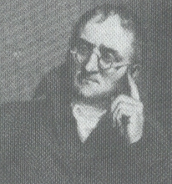
The structure of the atom
The Ancient Greeks used to believe that everything was made up of very small particles. I did some experiments in 1808 that proved this and called these particles ATOMS:
Dalton
ELECTRON – negative, mass nearly nothing
NEUTRON – neutral, same mass as proton (“1”)
PROTON – positive, same mass as neutron (“1”)

Slide 3
Mass and atomic number
Particle | Relative Mass | Relative Charge
Proton | 1 | 1
Neutron | 1 | 0
Electron | 0 | -1
MASS NUMBER = number of protons + number of neutrons
4
He
SYMBOL
2
PROTON NUMBER = number of protons (obviously)

Slide 4
Mass and atomic number
How many protons, neutrons and electrons?
1
11
16
H
B
O
1
5
8
23
35
238
Na
Cl
U
11
17
92

Slide 5
Isotopes
An isotope is an atom with a different number of neutrons:
Notice that the mass number is different. How many neutrons does each isotope have?
16
17
18
O
O
O
8
8
8
Each isotope has 8 protons – if it didn’t then it just wouldn’t be oxygen any more.

Slide 6
Electron structure
Consider an atom of Potassium:
39
K
19
Nucleus
Potassium has 19 electrons. These are arranged in shells…
The inner shell has __ electrons
The next shell has __ electrons
The next shell has __ electrons
The next shell has the remaining __ electron
Electron structure
= 2,8,8,1

Slide 7
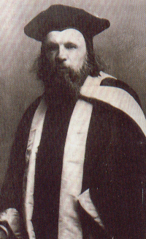
Periodic table
The periodic table arranges all the elements in groups according to their properties.
Vertical columns are called GROUPS
Mendeleev
Horizontal rows are called PERIODS

Slide 8
The Periodic Table
Fact 1: Elements in the same group have the same number of electrons in the outer shell (this correspond to their group number)
 |  |  |  |  | H |  |  |  |  |  |  |  |  |  |  |  | He
Li | Be |  |  |  |  |  |  |  |  |  |  | B | C | N | O | F | Ne
Na | Mg |  |  |  |  |  |  |  |  |  |  | Al | Si | P | S | Cl | Ar
K | Ca |  |  |  |  |  | Fe |  | Ni | Cu | Zn |  |  |  |  | Br | Kr
 |  |  |  |  |  |  |  |  |  | Ag |  |  |  |  |  | I | Xe
 |  |  |  |  |  |  |  |  | Pt | Au | Hg
E.g. all group 1 metals have __ electron in their outer shell
These elements have __ electrons in their outer shells
These elements have __ electrons in their outer shell

Slide 9
The Periodic Table
Fact 2: As you move down through the periods an extra electron shell is added:
E.g. Lithium has 3 electron in the configuration 2,1
 |  |  |  |  | H |  |  |  |  |  |  |  |  |  |  |  | He
Li | Be |  |  |  |  |  |  |  |  |  |  | B | C | N | O | F | Ne
Na | Mg |  |  |  |  |  |  |  |  |  |  | Al | Si | P | S | Cl | Ar
K | Ca |  |  |  |  |  | Fe |  | Ni | Cu | Zn |  |  |  |  | Br | Kr
 |  |  |  |  |  |  |  |  |  | Ag |  |  |  |  |  | I | Xe
 |  |  |  |  |  |  |  |  | Pt | Au | Hg
Sodium has 11 electrons in the configuration 2,8,1
Potassium has 19 electrons in the configuration __,__,__

Slide 10
The Periodic Table
Fact 3: Most of the elements are metals:
These elements are metals
 |  |  |  |  | H |  |  |  |  |  |  |  |  |  |  |  | He
Li | Be |  |  |  |  |  |  |  |  |  |  | B | C | N | O | F | Ne
Na | Mg |  |  |  |  |  |  |  |  |  |  | Al | Si | P | S | Cl | Ar
K | Ca |  |  |  |  |  | Fe |  | Ni | Cu | Zn |  |  |  |  | Br | Kr
 |  |  |  |  |  |  |  |  |  | Ag |  |  |  |  |  | I | Xe
 |  |  |  |  |  |  |  |  | Pt | Au | Hg
This line divides metals from non-metals
These elements are non-metals

Slide 11
The Periodic Table
Fact 4: (Most important) All of the elements in the same group have similar PROPERTIES. This is how I thought of the periodic table in the first place. This is called PERIODICITY.
 |  |  |  |  | H |  |  |  |  |  |  |  |  |  |  |  | He
Li | Be |  |  |  |  |  |  |  |  |  |  | B | C | N | O | F | Ne
Na | Mg |  |  |  |  |  |  |  |  |  |  | Al | Si | P | S | Cl | Ar
K | Ca |  |  |  |  |  | Fe |  | Ni | Cu | Zn |  |  |  |  | Br | Kr
 |  |  |  |  |  |  |  |  |  | Ag |  |  |  |  |  | I | Xe
 |  |  |  |  |  |  |  |  | Pt | Au | Hg
E.g. consider the group 1 metals. They all:
Are soft
Can be easily cut with a knife
React with water

Slide 12
Newlands vs. Mendeleev
In the early 19th Century scientists knew about 60 of the 100 _______ we now know of. It had also been seen that some elements had very similar _______ to each other. John Newlands was the first scientist to attempt to use these properties to put the elements into a ______ (in 1869):
Li | Be | B | C | N | O | F | Na | Mg | Al
Mendeleev came along in 1869 and made a very important change: he included _____ to account for missing elements that hadn’t yet been __________.
Li | Be | B | C | N | O | F |  | Na | Mg | Al
Using these gaps he could predict the properties of the undiscovered elements by considering the properties of the known elements ______ and below it. Quite useful really, as the _____ gases (helium, neon and so on) weren’t discovered until 30 years later. We now use ______ configuration as a basis for grouping elements.
Words – gaps, properties, noble, above, table, electron, elements, discovered

Slide 13
Bonding
Cl
Hi. My name’s Johnny Chlorine. I’m in Group 7, so I have 7 electrons in my outer shell
I’d quite like to have a full outer shell. To do this I need to GAIN an electron. Who can help me?
Cl

Slide 14
Bonding
Cl
Here comes one of my friends, Harry Hydrogen
Hey Johnny. I’ve only got one electron but it’s really close to my nucleus so I don’t want to lost it. Fancy sharing?
H
Cl
H
Now we’re both really stable. We’ve formed a covalent bond.

Slide 15
Bonding
Cl
Here comes another friend, Sophie Sodium
Na
Hey Johnny. I’m in Group 1 so I have one electron in my outer shell. Unlike Harry, this electron is far away from the nucleus so I’m quite happy to get rid of it. Do you want it?
Okay
-
+
Cl
Na
Now we’ve both got full outer shells and we’ve both gained a charge. We’ve formed an IONIC bond.

Slide 16
Covalent bonding
Consider an atom of hydrogen:
Notice that hydrogen has just __ electron in its outer shell. A full (inner) shell would have __ electrons, so two hydrogen atoms get together and “_____” their electrons:
Now they both have a ____ outer shell and are more _____. The formula for this molecule is H₂.
When two or more atoms bond by sharing electrons we call it ____________ BONDING. This type of bonding normally occurs between _______ atoms. It causes the atoms in a molecule to be held together very strongly but there are ____ forces between individual molecules. This is why covalently-bonded molecules have low melting and boiling points (i.e. they are usually ____ or ______).
Words – gas, covalent, non-metal, 1, 2, liquid, share, full, weak, stable

Slide 17
Dot and cross diagrams
Water, H₂O:
Step 1: Draw the atoms with their outer shell:
Step 2: Put the atoms together and check they all have a full outer shell:
H
O
H
O
H
H
Oxygen, O₂:
O
O
O
O

Slide 18
Dot and cross diagrams
Nitrogen, N₂:
Methane CH₄:
H
N
N
H
C
H
H
Ammonia NH₃:
Carbon dioxide, CO₂:
H
N
H
O
C
O
H

Slide 19
Ions
An ion is formed when an atom gains or loses electrons and becomes charged:
-
The electron is negatively charged
+
The proton is positively charged
+
If we “take away” the electron we’re left with just a positive charge:
+
This is called an ion (in this case, a positive hydrogen ion)

Slide 20
Ionic bonding
This is where a metal bonds with a non-metal (usually). Instead of sharing the electrons one of the atoms “_____” one or more electrons to the other. For example, consider sodium and chlorine:
Sodium has 1 electron on its outer shell and chlorine has 7, so if sodium gives its electron to chlorine they both have a ___ outer shell and are ______.
Na
Cl
+
-
A _______ charged sodium ion
A _________ charged chloride ion
Na
Cl
As opposed to covalent bonds, ionic bonds form strong forces of attraction between different ions due to their opposite ______, causing GIANT IONIC STRUCTURES to form (e.g sodium chloride) with ______ melting and boiling points:

Slide 21
Some examples
Magnesium chloride:
-
2+
Cl
Cl
+
Mg
Mg
-
Cl
Cl
MgCl₂
Calcium oxide:
2+
2-
Ca
+
Ca
O
O
CaO

Slide 22
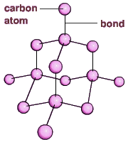


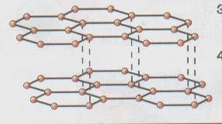
Giant structures (“lattices”)
1. Diamond – a giant covalent structure with a very ____ melting point due to ______ bonds between carbon atoms
3. Sodium chloride – a giant ionic lattice with _____ melting and boiling points due to ______ forces of attraction. Can conduct electricity when _______.
4. Metals – the __________ in metals are free to move around, holding the _____ together and enabling it to conduct _________
+
+
+
2. Graphite – carbon atoms arranged in a layered structure, with free _______ in between each layer enabling carbon to conduct _________
+
+
+
+
+
+

Slide 23
Group 1 – The alkali metals
Li
Na
K
Rb
Cs
Fr

Slide 24
Group 1 – The alkali metals
Some facts…
1) These metals all have ___ electron in their outer shell
2) Reactivity increases as you go _______ the group. This is because the electrons are further away from the _______ every time a _____ is added, so they are given up more easily.
3) They all react with water to form an alkali (hence their name) and __________, e.g:
Potassium + water potassium hydroxide + hydrogen
2K_{(s)} + 2H₂O_{(l)} 2KOH_{(aq)} + H_{2(g)}
Words – down, one, shell, hydrogen, nucleus

Slide 25
Group 0 – The Noble gases
He
Ne
Ar
Kr
Xe
Rn

Slide 26


Group 0 – The Noble gases
Some facts…
1) All of the noble gases have a full outer shell, so they are very _____________
2) They all have low melting and boiling points
3) They exist as single atoms rather then diatomic molecules
Helium is lighter then air and is used in balloons and airships (as well as for talking in a silly voice)
Argon is used in light bulbs (because it is so unreactive) and argon , krypton and neon are used in fancy lights

Slide 27
Group 7 – The halogens
F
Cl
Br
I
At

Slide 28
Group 7 – The Halogens
Some facts…
Decreasing
reactivity
1) Reactivity DECREASES as you go down the group
(This is because the electrons are further away from the nucleus and so any extra electrons aren’t attracted as much).
2) They exist as diatomic molecules (so that they both have a full outer shell):
Cl
Cl
3) Because of this fluorine and chlorine are liquid at room temperature and bromine is a gas

Slide 29
The halogens – some reactions
1) Halogen + metal:
+
-
Na
+
Cl
Na
Cl
Halogen + metal ionic salt
2) Halogen + non-metal:
H
+
Cl
Cl
H
Halogen + non-metal covalent molecule

Slide 30
Displacement reactions
To put it simply, a MORE reactive halogen will displace a LESS reactive halogen from a solution of its salt.
F
Cl
Br
I
 | Potassium chloride KCl_{(aq)} | Potassium bromide KBr_{(aq)} | Potassium iodide KI _{(aq)}
Chlorine Cl₂
Bromine Br₂
Iodine I₂
Decreasing reactivity

Slide 31
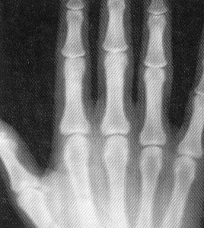

Halogen compounds
Silver halides (e.g. silver chloride, silver bromide etc)
These are used in photographic paper. They are reduced by light and x-ray radiation to leave a silver photographic image.
Hydrogen halides (e.g. hydrogen chloride, hydrogen fluoride)
When these dissolve in water they make acids and will turn universal indicator red.

Slide 32
Electrolysis of brine
Sodium chloride (salt) is made of an alkali metal and a halogen. When it’s dissolved we call the solution “brine”, and we can electrolyse it to produce 3 things…
Chlorine gas (Cl₂) – used to kill bacteria and to make acids, bleach and plastics
Hydrogen gas (H₂) – used to manufacture ammonia and margarine
Sodium chloride (brine)
NaCl_{(aq)}
Sodium hydroxide (NaOH_{(aq)}). Used to make soap, paper and ceramics
Positive electrode
Negative electrode

Slide 33
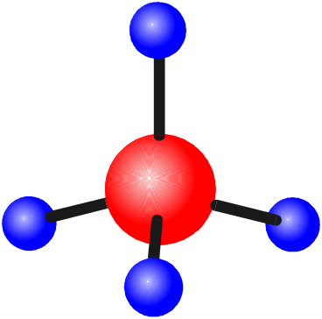
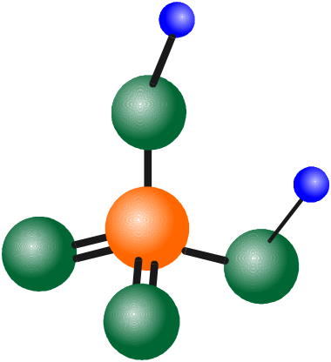

Chemical formulae
Methane, CH₄
Carbon dioxide, CO₂
Water, H₂O
Key
Hydrogen
Oxygen
Carbon
Sulphur
Ethyne, C₂H₂
Sulphuric acid, H₂SO₄

Slide 34
Chemical formulae
The chemical formulae of a molecule or compound is simply a way of showing the ratio of atoms in it. For example…
Na
Cl
= sodium chloride (NaCl)
K
I
= potassium iodide (KI)
O
K
N
O
= potassium nitrate (KNO₃)
O

Slide 35
Chemical formulae
Try drawing these:
Water H₂O
Carbon dioxide CO₂
Calcium sulphate CaSO₄
Magnesium hydroxide Mg(OH)₂

Slide 36
Naming compounds
Rule 1– If two identical elements combine then the name doesn’t change
This happens with the following elements:
H₂
N₂
O₂
F₂
Cl₂
Br₂
These elements always go around in pairs (diatomic molecules). For example, hydrogen looks like this:

Slide 37
Naming compounds
Rule 2 – When two elements join and one is a halogen, oxygen or sulphur the name ends with ____ide
e.g. Magnesium + oxygen magnesium oxide
Sodium + chlorine
Magnesium + fluorine
Lithium + iodine
Chlorine + copper
Oxygen + iron
KBr
LiCl
CaO
MgS
KF

Slide 38
Naming compounds
Rule 3 – When three or more elements combine and two of them are hydrogen and oxygen the name ends with hydroxide
e.g. Sodium + hydrogen + oxygen Sodium hydroxide
Potassium + hydrogen + oxygen
Lithium + hydrogen + oxygen
Calcium + hydrogen + oxygen
Mg(OH)₂

Slide 39
Naming compounds
Rule 4 – When three or more elements combine and one of them is oxygen the ending is _____ate
e.g. Copper + sulphur + oxygen Copper sulphate
Calcium + carbon + oxygen
Potassium + carbon + oxygen
Calcium + sulphur + oxygen
Magnesium + chlorine + oxygen
Calcium + oxygen + nitrogen
AgNO₃
H₂SO₄
K₂CO₃

Slide 40
Balancing equations
Consider the following reaction:
Sodium + water sodium hydroxide + hydrogen
Na
Na
+
O
+
H
H
H
H
H
O
This equation doesn’t balance – there are 2 hydrogen atoms on the left hand side (the “reactants” and 3 on the right hand side (the “products”)

Slide 41
Balancing equations
We need to balance the equation:
Sodium + water sodium hydroxide + hydrogen
Na
O
H
Na
H
H
O
+
+
O
Na
H
H
H
H
H
Na
O
Now the equation is balanced, and we can write it as:
2Na_{(s)} + 2H₂O_{(l)} 2NaOH_{(aq)} + H_{2(g)}

Slide 42
Simple formulae to learn
Covalent formulae
Ionic formulae
H₂O
CO₂
NH₃
H₂
O₂
N₂
SO₂
Water
Carbon dioxide
Ammonia
Hydrogen
Oxygen
Nitrogen
Sulphur dioxide
NaCl
CaCl₂
MgO
HCl
H₂SO₄
HNO₃
NaOH
Ca(OH)₂
CaCO₃
Al₂O₃
Fe₂O₃
Sodium chloride
Calcium chloride
Magnesium oxide
Hydrochloric acid
Sulphuric acid
Nitric acid
Sodium hydroxide
Calcium hydroxide
Calcium carbonate
Aluminium oxide
Iron oxide

Slide 43
Electrolysis
Electrolysis is used to extract a HIGHLY REACTIVE metal.
When we electrolysed copper chloride the negative chloride ions moved to the positive electrode and the positive copper ions moved to the negative electrode – OPPOSITES ATTRACT!!!
= chloride ion
= copper ion

Slide 44
Electrolysis equations
We need to be able to write “half equations” to show what happens during electrolysis (e.g. for copper chloride):
At the negative electrode the positive ions GAIN electrons to become neutral copper ATOMS. The half equation is:
Cu²⁺ + e⁻ Cu
2
At the positive electrode the negative ions LOSE electrons to become neutral chlorine MOLECULES. The half equation is:
Cl⁻ - e⁻ Cl₂
2
2

